Slide 1
CLASS 1 – 10.26.2021
SPORTS ANALYTICS
4:30 – 5:30 | 5 min-break
5:35 – 6:05 | 10 min break
6:15 – 7:00 | Guest Speaker
Today’s class:
* Course Overview
* 2020 & 2021 Sports Business Trends
* Pro Sports Attendance Trends | Spend to Win – Win to Fill the stands
* Predicting MLB Attendance – key variables
* Promotions to sell tickets
* Assignment 1 – Due Nov.8

Slide 2














Scott Lewis
Director of Strategic Initiatives & Business Intelligence
Zoomph

Slide 3
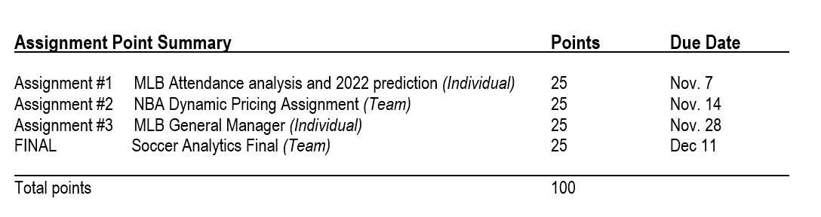
COURSE OVERVIEW
Business Analytics – Revenue Drivers
Today: Attendance/Ticket Sales
11/2: Ticket Pricing & Total Fan Cost
11/9: Sponsorship, F&B-Merch
Player Analytics
11/16: Major League Baseball
11/23: Soccer {Virtual}
11/30: NHL {Virtual}
12/7: NBA

Slide 4
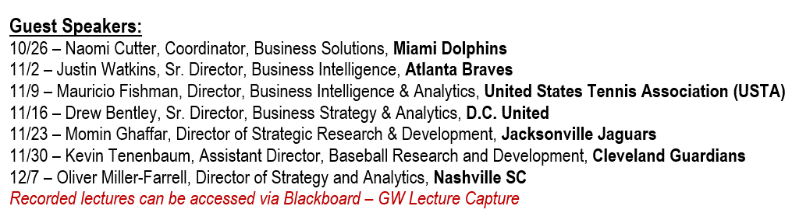
Guest Speakers

Slide 5
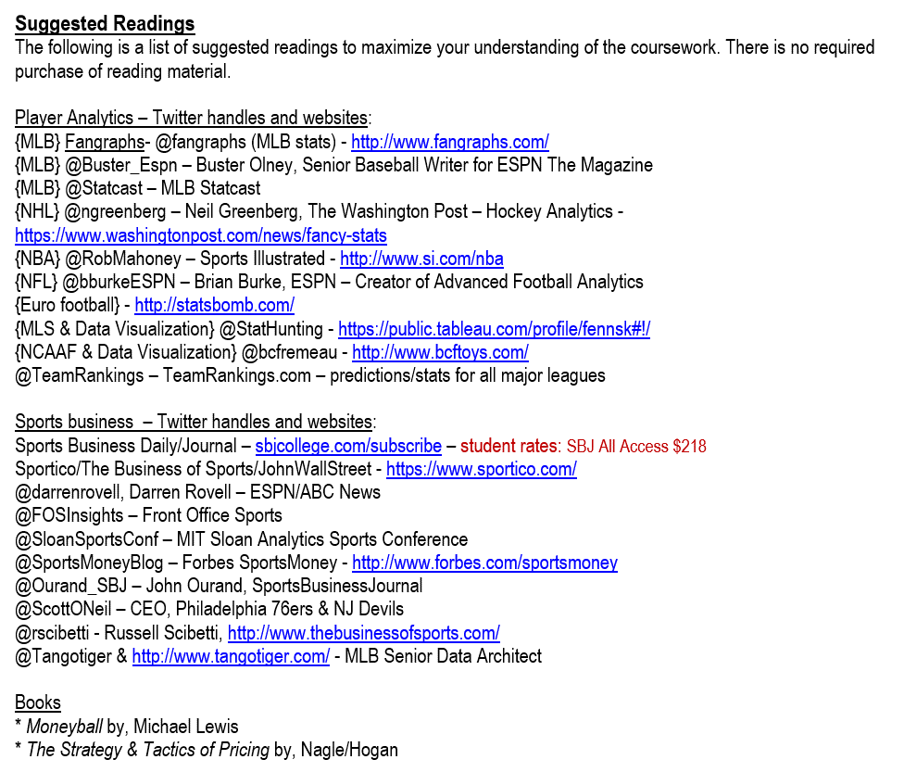

Slide 6
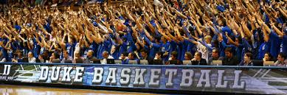
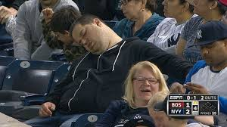
Be Duke Fans!

Slide 7
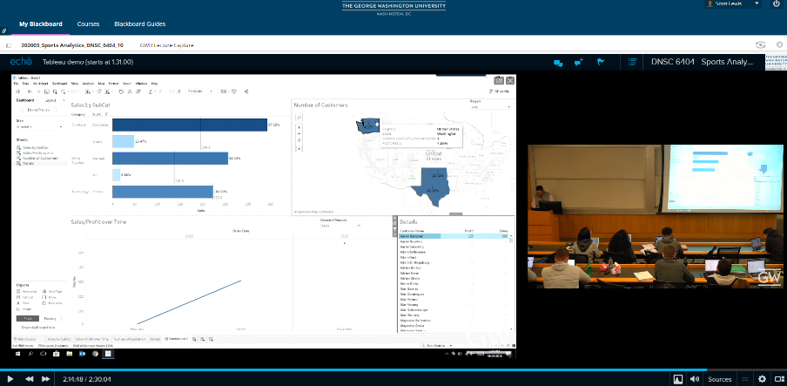
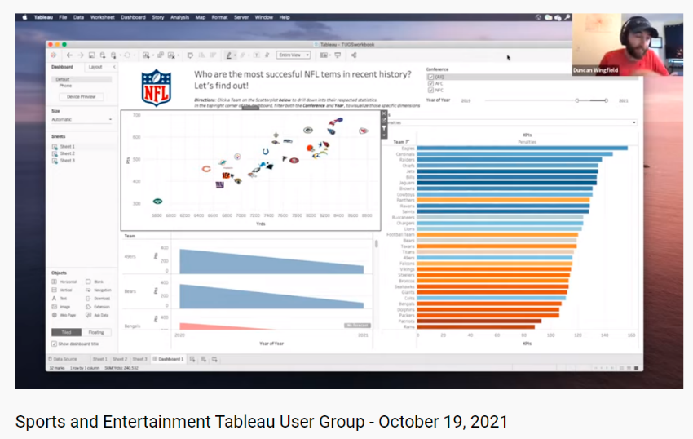

Tableau demo - Blackboard – GW Lecture Capture

Slide 8
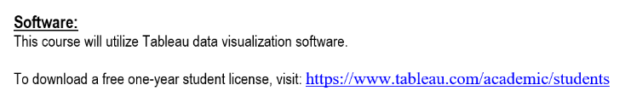
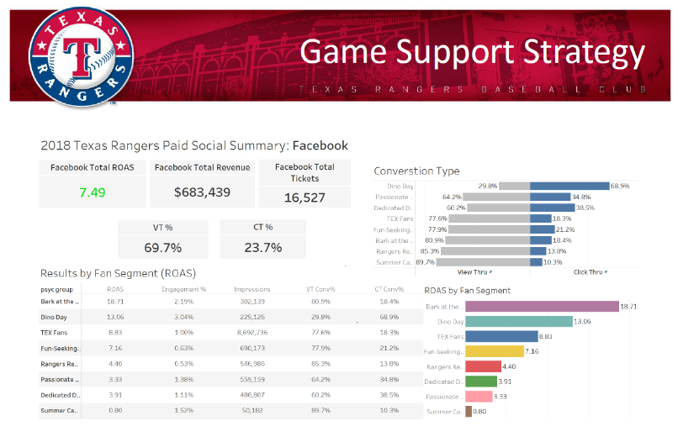

Slide 9
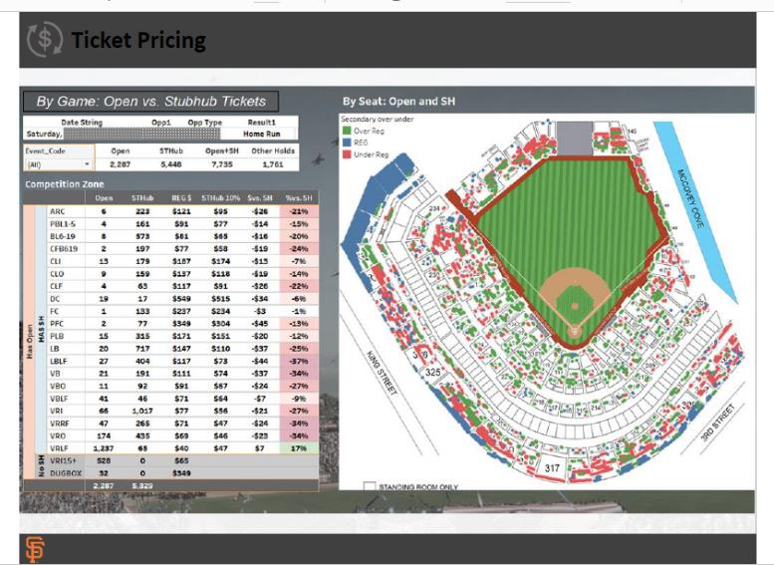
Notes:
Advanced – NFL Fantasy Football Draft - https://public.tableau.com/app/profile/the.will.jones/viz/2019TableauFantasyFootballDraftKit/WebDraftKitStandard

Slide 10
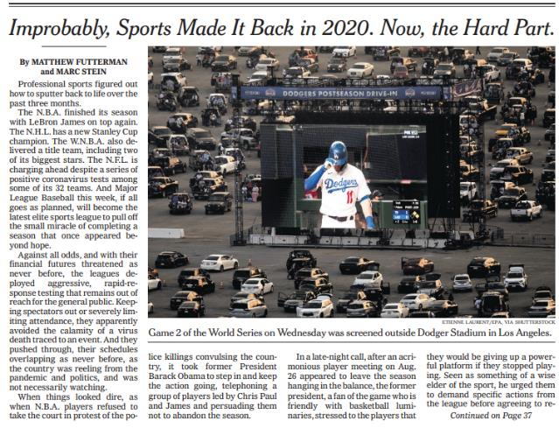
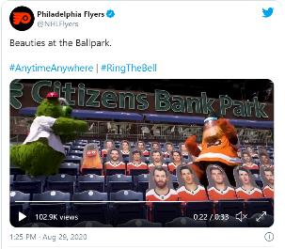
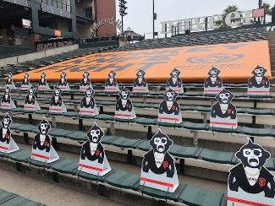
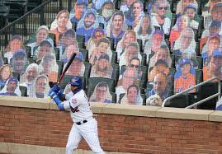
One year ago at this time…..
2021 season starts?:
* NBA: 12/22
* NHL: 1/1
* MLS: April
* MLB: April
* Olympics: July
% of Ttl Rev from Gamedays:
* NHL/MLS: 50%+
* NBA: 40%
* MLB: 33%
* NFL: 25%
Notes:
NY Times front page – 10.25.2020

Slide 11
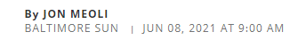
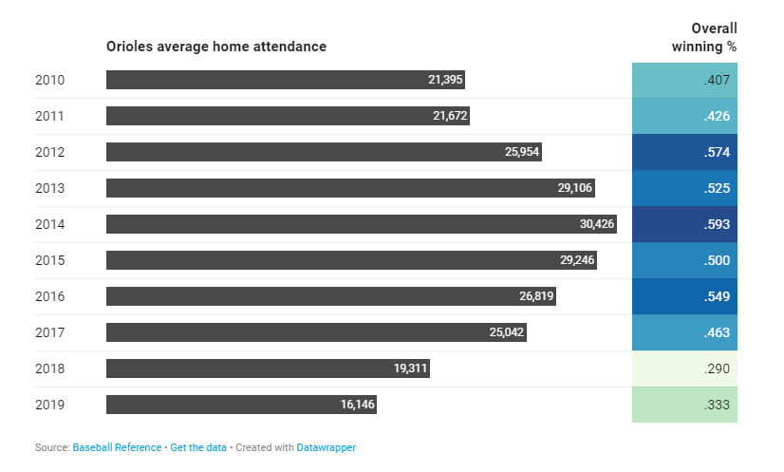
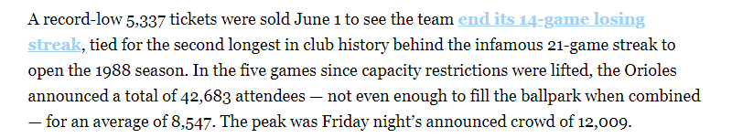
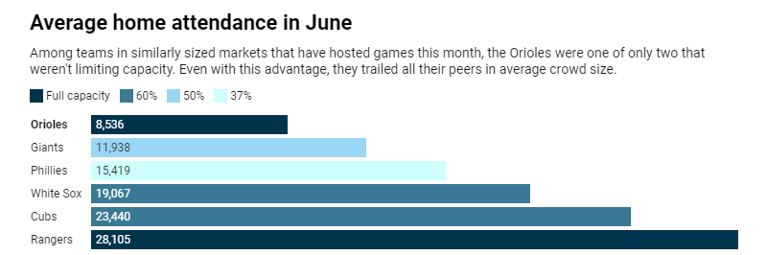

Slide 12
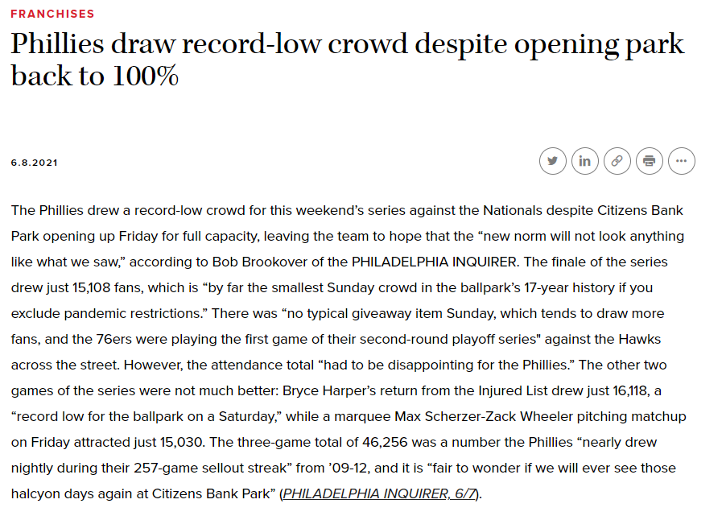

Slide 13
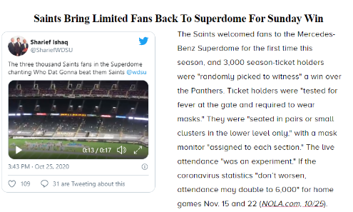
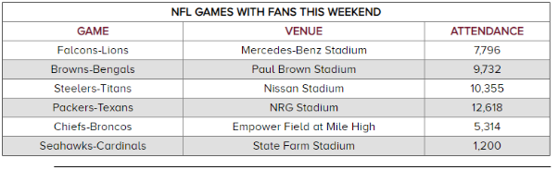
2020 VS. 2021 - NFL

Slide 14
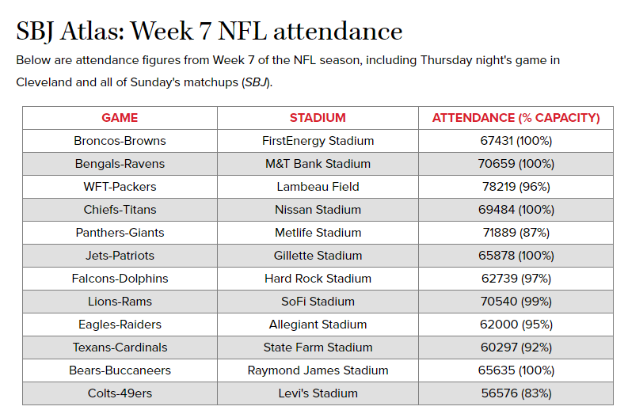
2020 VS. 2021 – NFL (cont.)

Slide 15
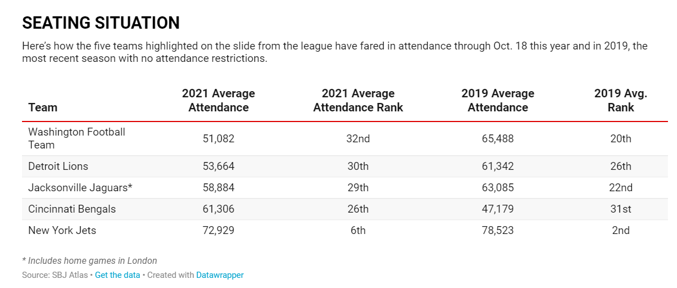

Slide 16
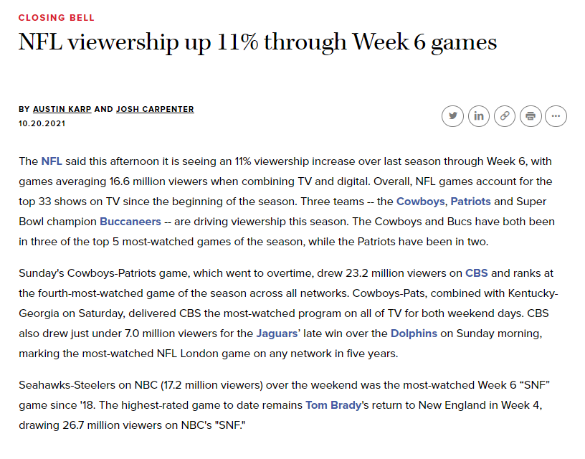
Notes:
https://www.sportsbusinessjournal.com/Daily/Closing-Bell/2021/10/20/NFL-Viewers.aspx

Slide 17
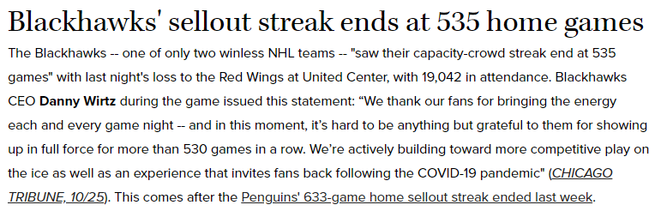
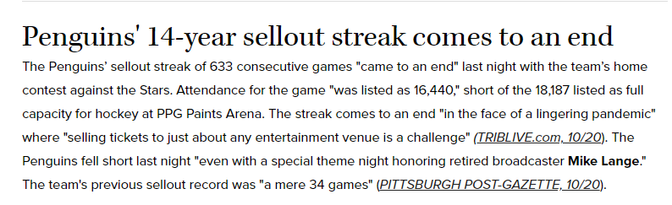
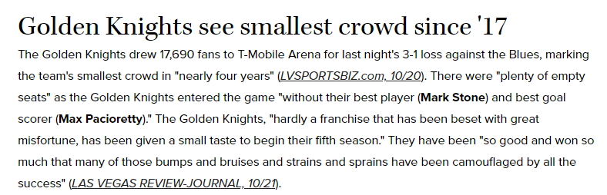
NHL Attendance – Past week

Slide 18
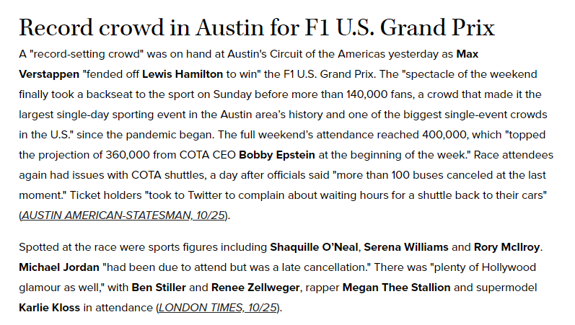
Attendance – Past week

Slide 19
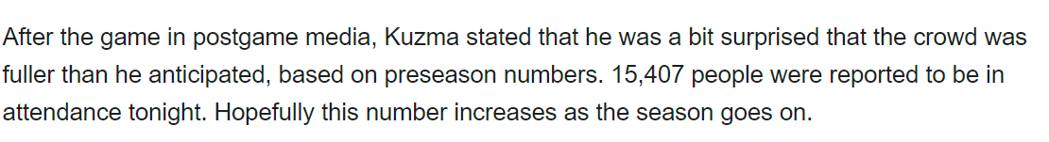
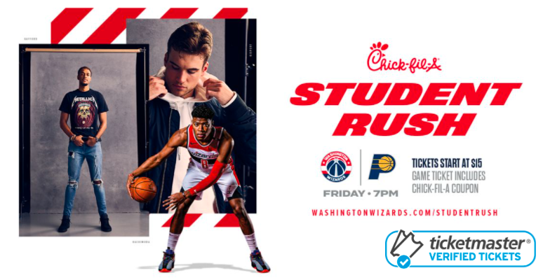
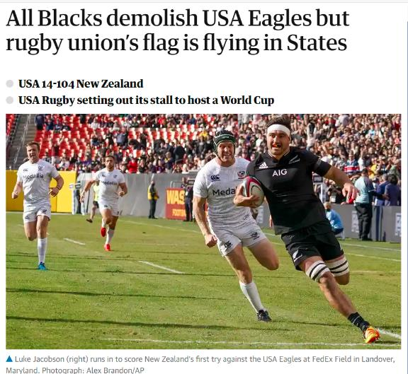
Attendance – Past weekend in Wash, DC
Wizards 2021-2022 Home Opner: 75% capacity
Organizers of the doubleheader, as well as coaches for both teams, are expecting a crowd in the neighborhood of 20,000 for the Army-Navy opener and close to capacity attendance for the USA-New Zealand contest.

Slide 20
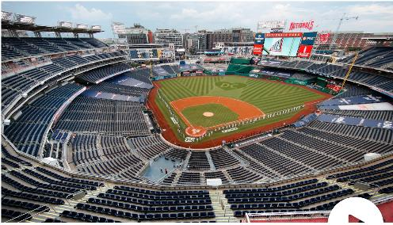
The Year (Month) in sports (cont.)
SPORTS TV RATINGS
Ratings for the N.B.A. finals were down 49 percent, and the N.H.L.’s Stanley Cup finals were down a whopping 61 percent. Baseball, golf, tennis, horse racing and other sports have all seen huge declines. Even the usually untouchable N.F.L. was down 13 percent through Week 5.
Fox drew another record-low World Series audience with Game 2 last night, SBJ’s Austin Karp notes. The Rays’ 6-4 win over the Dodgers averaged 8.95 million viewers, below the previous low set for Game 1 on Tuesday night (9.195 million). Despite the decline, Fox did win primetime again among all networks.

Slide 21
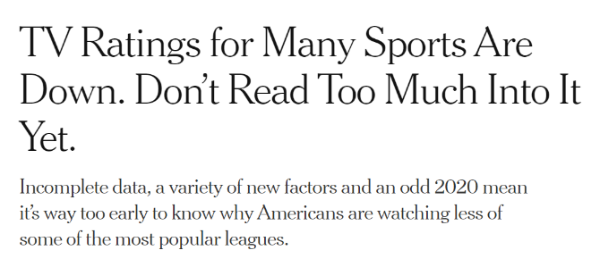
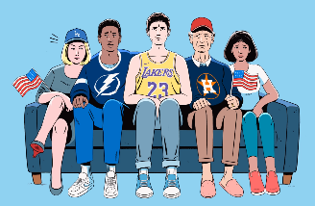
Competition – Sports Equniox:
On one Sunday in September, the N.F.L., N.B.A., M.L.B., N.H.L., M.L.S. and W.N.B.A. all had games — the first time that has happened.
Fewer tv viewers in general
News audience is up
Notes:
https://www.nytimes.com/2020/10/22/sports/tv-ratings-sports.html#:~:text=Compared%20with%20September%202019%2C%20total,trends%20that%20affected%20some%20sports.

Slide 22
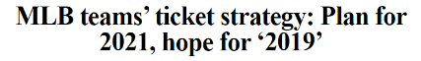
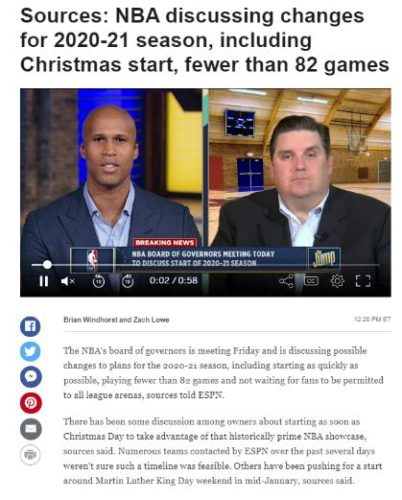
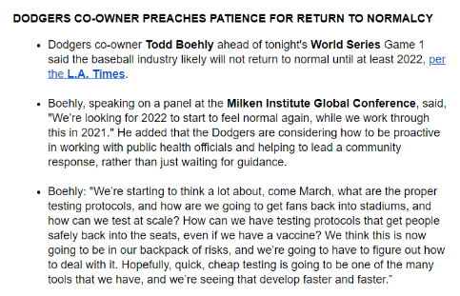
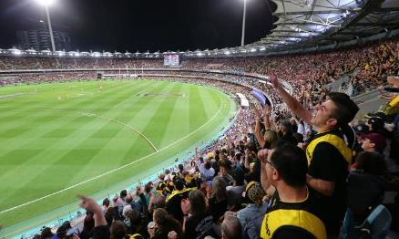
2021?
Notes:
https://www.espn.com/nba/story/_/id/30174384/sources-nba-discussing-changes-2020-21-season-including-quick-start-less-82-games

Slide 23
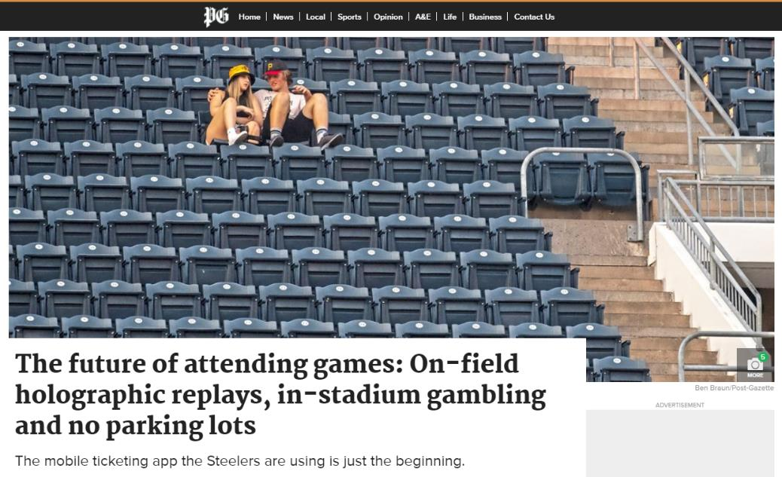
Prior to March 2020, the relationship between fans and the sports they consume live was already evolving, if not deteriorating.
In 2019, college football attendance hit its lowest point since 1996, marking the eighth time in a nine-year stretch in which the national average fell.
Before a slight uptick in 2019-20, Division I men’s college basketball attendance nationally had decreased for 13 consecutive years. Average Major League Baseball attendance was down 13% in 2019 from 11 years earlier. That same year, even the mighty National Football League saw its lowest attendance figures in 15 years.
The shrinking crowds had triggered changes.
Since 2010, 21 of MLB’s 30 franchises had their stadium’s seating capacity reduced at some point or moved into a new, smaller venue. Twelve NFL teams had done the same in that time. A New York magazine story in December 2019 even predicted that in the next decade, a professional league would experiment with playing games on soundstages to maximize the at-home viewing experience.
Notes:
https://www.post-gazette.com/sports/steelers/2021/10/11/games-of-the-future-football-baseball-hockey-gambling-technology-Steelers/stories/202109190013
Losing the fans
Prior to March 2020, the relationship between fans and the sports they consume live was already evolving, if not deteriorating.
In 2019, college football attendance hit its lowest point since 1996, marking the eighth time in a nine-year stretch in which the national average fell.
Before a slight uptick in 2019-20, Division I men’s college basketball attendance nationally had decreased for 13 consecutive years. Average Major League Baseball attendance was down 13% in 2019 from 11 years earlier. That same year, even the mighty National Football League saw its lowest attendance figures in 15 years.
The shrinking crowds had triggered changes.
Since 2010, 21 of MLB’s 30 franchises had their stadium’s seating capacity reduced at some point or moved into a new, smaller venue. Twelve NFL teams had done the same in that time. A New York magazine story in December 2019 even predicted that in the next decade, a professional league would experiment with playing games on soundstages to maximize the at-home viewing experience.
The reasons for those declines vary, but they centered around a larger idea: How valuable was the in-person sports viewing experience in the 21st century?
“I would not be shocked if live attendance is substantially lower in the post-pandemic era than it was in the pandemic era,” said Brad Humphreys, an economics professor at West Virginia. “It’s not hard to imagine that people have realized they can get just as much enjoyment following the Steelers on social media and watching the games on television and interacting with other fans on social media.”
The question then becomes pretty simple: What do these franchises and schools do to create an experience that fans can only get inside the walls of the venue?
Mobile ticketing just the start
Some of that work has taken place over the past several years. Many franchises and organizations have ramped up their digital footprints, investing more heavily in team-issued apps and over-the-top media services.
Through the Steelers’ official app, fans can access real-time replays and game stats, report an incident, receive help navigating Heinz Field, and use available augmented reality technology at displays in the stadium’s Great Hall, where the team’s Super Bowl trophies and a Terrible Towel exhibit are located.
On that same app, fans can use mobile ticketing — an initiative the Steelers and teams across professional sports have increasingly championed.
Though a failure by some guests to download tickets to their phones led to long lines at the team’s home opener in September — a snafu the franchise is working on — the Steelers’ vice president of sales and marketing, Ryan Huzjak, said mobile tickets are easier to transfer and that less fraud is associated with them, among other benefits.
“If something were to occur, contract tracing or otherwise, with a paper ticket, that’s largely an anonymous device,” Mr. Huziak said. “You don’t know who has that ticket.
“With a mobile ticket, you have a better connection to the actual attendee. Those things became critical in terms of looking at the logistics of communicating to fans, changing policies, updating policies, or just general information and preparedness.”
Even before the pandemic, teams were doing what they could to offer more than just a game to fans who came near the stadiums, arenas and ballparks on game days, transforming the blocks around a venue into entertainment districts.
It’s a development that was a major part of “The Future of Sports,” a 2015 report from Attention Span Media, an agency that works with management teams on strategy.
Projects like Ballpark Village in St. Louis and Patriots Place in Foxborough, Mass., are examples of a larger trend that the report described as the stadium space extending “outward to include a greater variety of ways fans can experience game day. ... Tickets will no longer be sold just for seats in view of the field; open-concept venues will provide tiers of access that allow fans to roam the complex. The tailgating experience will come inside the gates.”
“It’s like full malls that are attached to stadiums and green outdoor space and all of that,” said Josh McHugh, the editor-in-chief of Attention FWD, Attention Span Media’s content arm. “I think you’re going to see a lot more of that, just a better use of space and stadium operators figuring out how to keep people there longer so you’re not just driving up, going to the game and leaving. You’re making a day of it or maybe an overnight of it.”
That was only one of a number of projections featured in “The Future of Sports” about the in-stadium experience. It envisioned a future in the five to 10 years after its publication that included video walls built into stadium architecture, on-field holographic replays and glasses-free three-dimensional technology in luxury boxes.
With self-driving cars and ride-sharing services dropping fans off closer to the stadium — and fans not necessarily driving themselves to games — the seas of asphalt that surround many stadiums could be significantly reduced, with tailgating and other pregame festivities moving inside the larger stadium complex.
It doesn’t stop there. Mr. McHugh said apps are in development similar to Waze, the popular navigation app, that could be used in stadiums. A fan would type in where they want to go, be it the bathroom or concession stand, and it will show them the way to do it that takes the least amount of time.
This year, the Steelers introduced mobile ordering for concessions. Mr. Huzjak said they’ll look to expand their offerings in the years to come, from self-serve to walk-through options that will allow attendees to get products quicker and more efficiently, cutting down on those long lines with which any sports fan missing a key play is painfully familiar.
Then there’s augmented and virtual reality (AR and VR). Through AR technology, a fan could zoom in on different parts of the field, isolate a play and get a personalized replay. In essence, it would make fans the producers of their own, personalized broadcasts.
“One of the big drawbacks to being at a game live is something will be going on in the stands ... you’ll be having a conversation or you’ll be looking at one part of the play and something remarkable happens and you’ll miss it,” Mr. McHugh said.
“You always hope that they caught it and that they’ll be replaying it on the Jumbotron, but that doesn’t always happen. To be able to control your own live production is going to be a fantastic addition to the mix.”
Skin in the game
No conversation around sports in 2021 can be untethered from gambling, including how it affects the way fans in a stadium or arena consume the games they’re there to see. In August 2020 alone, Americans bet $2.1 billion on sports, a single-month record at the time.
Capital One Arena and Nationals Park in Washington have sportsbooks inside the venues. The Phoenix Suns are having one added to their arena, and in August, the Arizona Cardinals reached a deal to become the first NFL team with an on-site sportsbook.
Like dozens of other professional teams, the Steelers have partnerships with sports betting companies — in their case, BetMGM and Unibet.
How teams incorporate gambling over the course of a game — apps where fans can make live bets or gambling lounges inside the stadium, for example — could have a sizable role in shaping their present and future financial success.
“That has helped the value of the teams because it’s a profit center now and it has kept fan interest,” said Ronald Dick, an associate professor of sports marketing at Duquesne University.
“I hear people say, ‘I can’t watch a sporting event unless I have some skin in the game. Even if it’s a small bet, I need to have a couple of dollars on it.’”
But back to the game
For all the accessories, features and trappings that will make the stadiums, arenas and ballparks of the future radically different from what they are today, the central appeal will remain. All the bells and whistles can help keep fans’ attention, but it’s the game that brings them there in the first place.
“The underlying pull is there,” Mr. Giorgio, the Deloitte exec, said. “It’s been there for thousands of years.
“People want to go to sporting events and see sporting events and have that collective experience. I don’t think that’s going away. It’s just what people expect around that that’s going to be important.”

Slide 24
MLB Attendance Hits 37-Year Low
Major League Baseball welcomed fans back into the stands in 2021, but attendance was at a generational low.
The league saw 45.3 million fans attend regular-season games in 2021, a 33.9% drop from the 68.5 million in 2019, and the lowest figure since 1984.
Certain caveats apply: Many teams only opened to full capacity by midseason, and the Toronto Blue Jays played at alternate sites until late July due to Canadian travel restrictions.
However, fans also watched fewer games from home.
Viewership was down 12% compared to 2019, as of late August. This was partly related to regional games moving from Fox to Bally Sports in March, cutting off some viewers with YouTube TV, Dish, and Sling TV.
The “Field of Dreams” game brought in viewership 135% above that of a typical Fox-broadcasted game.
MLB will begin a seven-year, $5.1 billion broadcasting deal with Fox next year.
MLB is headed into a potentially contentious labor negotiation, with the current collective bargaining agreement expiring on Dec. 1. Owners have sought to expand the MLB playoffs as a way of attracting more fans.
Notes:
Front Office Sports eblast – 10/5/21

Slide 25
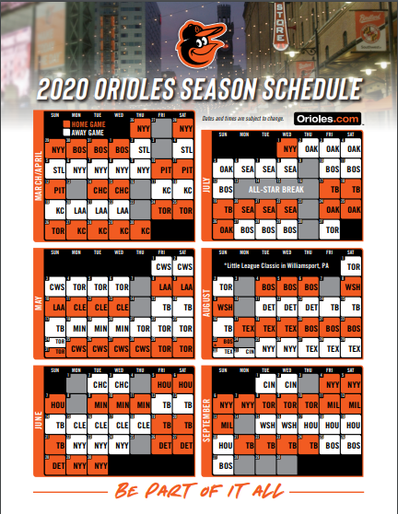
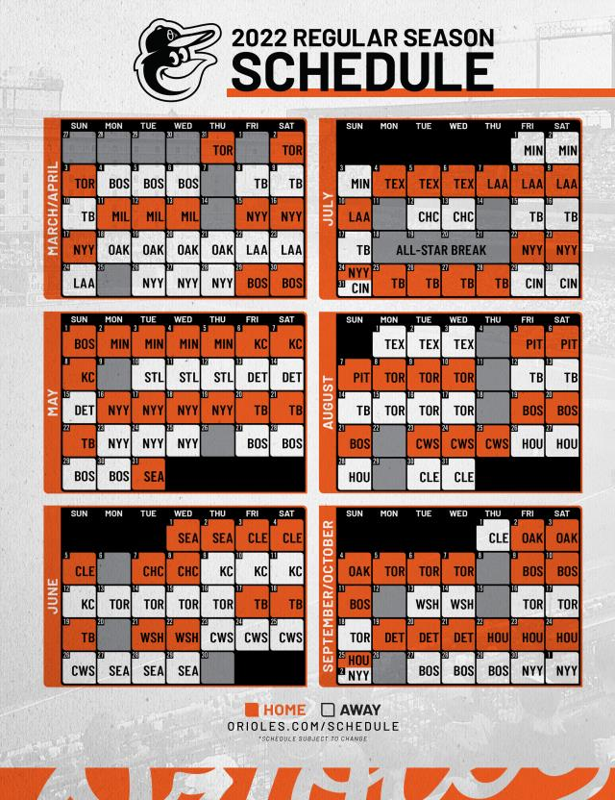
Assignment #1: Predicting Orioles 2022 Attendance by Game
Notes:
https://content.mlb.com/documents/2/8/8/291434288/2019_Printable_Schedule.pdf

Slide 26
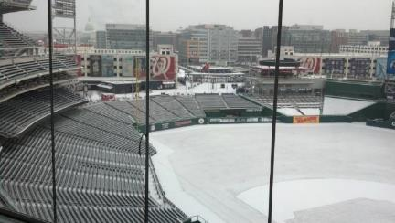
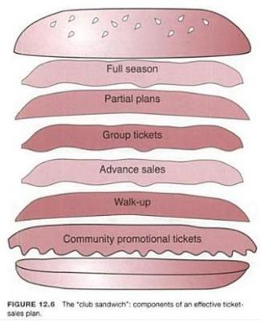
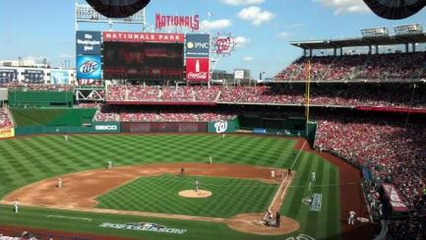
Attendance: #1 Revenue Driver/Lifeblood. Grow the fan base & fill the seats
Sports is a want, not a need – value is more important than price
FSE = Full Season Equivalent
Fulls + Partials

Slide 27
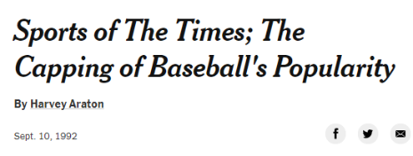
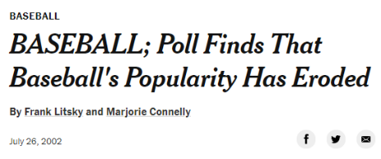
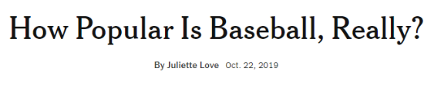
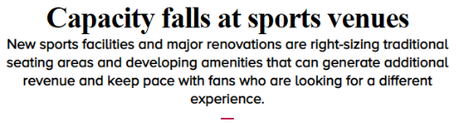

Slide 28
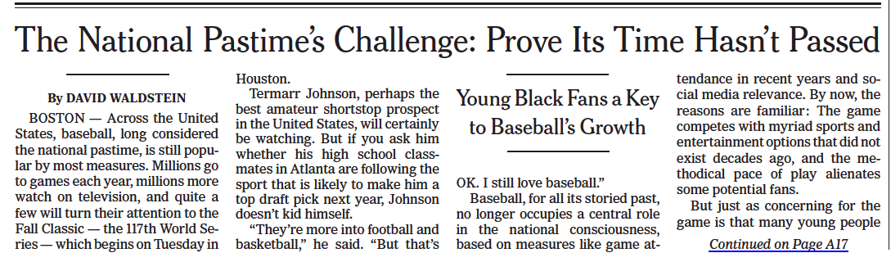
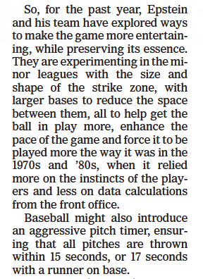

Notes:
NYT 10.25.2021

Slide 29


Attendance – More challenging then ever before
“Mets ending season that has questioned fan loyalty.”
9.20.12 vs. Phillies: “The game was viewed by a crowd of, at most, a couple thousand people and played in the closest thing to silence attainable at an American professional sporting event.” – N.Y. Times
Notes:
http://www.nytimes.com/2012/09/22/sports/baseball/mets-ending-season-that-has-questioned-fan-loyalty.html?pagewanted=all

Slide 30


There are, of course, explanations. Burns said attendance is dependent on a litany of factors: the team’s performance, the weather, whether a bobblehead is handed out, etc. But this drop from last year’s full season average of 31,230, Burns said, was predictable for two additional reasons. Last July, the Nats hosted the All-Star Game, an event that usually leads to an increase in overall attendance, both because of ticket-buying incentives teams offer and general enthusiasm around the game. Plus, 2018 was, as Burns said, “a season of very high expectations that weren’t necessarily met,” which is something of an understatement.
Notes:
https://www.washingtonpost.com/sports/nationals/why-is-nationals-attendance-down-its-a-good-question-without-a-simple-answer/2019/06/12/971f5638-8d42-11e9-b08e-cfd89bd36d4e_story.html

Slide 31



Notes:
https://www.nytimes.com/interactive/2019/10/22/sports/baseball/baseball-popularity-world-series.html?searchResultPosition=4

Slide 32


NBA ATTENDANCE – PAST 15 SEASONS

Slide 33



MLB ATTENDANCE - 2018
Historically bad weather:
* Record 28 ppds. April
* 54 ppds. for the season – most since 1989
On-field performance:
* For the first time in the league’s history, eight teams finished with 95 losses or more, and three of them (Orioles, White Sox and Royals) lost more than 100.
* For the first time in the league’s history, there were more strikeouts (41,207) than hits (41,019). This marked the 11th straight season that strikeouts increased from the season prior, and the league batting average was .248, the lowest since 1972.
* HRs down 9% from 2017 – 5,585 vs. 6,105
Source: Forbes.com, 10.3.18
Notes:
https://www.sportsbusinessdaily.com/Journal/Issues/2018/10/08/Leagues-and-Governing-Bodies/MLB-Attendance.aspx
https://www.forbes.com/sites/maurybrown/2018/10/03/how-mlb-attendance-dropped-below-70-million-for-first-time-in-15-years/#11fc8c0161bf

Slide 34



The average time of a nine-inning MLB game has "once again reached 3 hours and 5 minutes, equaling the mark" set in '17, according to Gabe this season, mound visits were "reduced to five, and innings breaks in most games to two minutes, with Commissioner Rob Manfred set to unilaterally impose a three-batter minimum on relievers" in '20. Lacques of USA TODAY. That comes just one season after the average duration of a game "ticked back down to three hours." Before Hitters this season are "seeing an average" of 3.92 pitches per plate appearance, the "highest mark in the 21 seasons the stat has been tracked." There has also been a "record number of strikeouts -- 8.73 per team per game, shattering last year's mark of 8.48." That equals a "lot of time on the game clock before a ball's even put in play." While there is a "perception that the three-batter minimum will greatly reduce game times thanks to fewer mid-inning pitching changes, teams are using fewer pitchers per game this year (4.27) than last (4.36)."
2020 Rule Changes:
* Universal DH
* Runner on 2nd in Extra Innings
* Relievers face min 3 batters
= Avg. game time: 3h11m
Notes:
https://www.sportsbusinessdaily.com/Daily/Issues/2019/09/04/Leagues-and-Governing-Bodies/MLB.aspx

Slide 35
Orioles Attendance – Average/Game
14
20
23
24
21
24
26
20
18
13
19
20
23
26
28
26

Slide 36
Nationals Attendance – Average/Game
2005: 33,725 (11)
2006: 26,581 (21)
2007: 24,217 (25)
2008: 28,667 (19)
2009: 22,679 (24)
2010: 22,563 (23)
2011: 24,878 (20 )
2012: 30,010 (14)
2013: 32,745 (11)
2014: 31,844 (12)
2015: 32,343 (11)
2016: 30,641 (14)
2017: 31,172 (11)
2018: 31,620 (11)
2019: 27,898 (16)
2021: 18,319 (18)
14
14
11
21
25
19
24
23
20
14
11
12
11
14
11
11
16
18
20
20
RFK STADIUM
NATIONALS PARK
Notes:
http://www.espn.com/mlb/attendance

Slide 37


Nats record low attendance
Notes:
http://voices.washingtonpost.com/dcsportsbog/2010/09/the_nats_record-low_crowd.html

Slide 38

Attendance rarity (2009)
He and his mathematician friends figured out that the odds of my going 0-19 this year at Nats Park were 1 in 131,204.
Notes:
http://voices.washingtonpost.com/dcsportsbog/2009/10/the_nats_unluckiest_fan.html

Slide 39


HARPER – HOME DEBUT – MAY 2012
4/16/12 – Strasburg’s first home start of the season: 16,245
5/1/12 – Harper’s first home game of his career: 22,675 (2,625 $2 Tickets)
From TiqIQ: "With the home average so high this season thanks to some marquee interleague matchups, this game sits well below that average. At the current price of $31 per seat, tonight's game is 69% below the Nats' 2012 average.

Slide 40



Strasburg impact/lack thereof…

Slide 41


Wash Football Team
The Wash. Football Team, who have made the playoffs just twice in the past decade, must now compete for fans’ dollars, time and loyalty with the Capitals, Nationals, Wizards and D.C. United, which this season opened a new stadium near Nationals Park. And on Sunday, many simply stayed away.
The announced attendance of 57,013 was the lowest for a Wash. Football Team home opener in the 21-year history of FedEx Field — down more than 21,000 from the 78,658 who attended the WFT 2017 home opener against the NFC East rival Philadelphia Eagles.
It also broke what the WFT have claimed is a 50-year streak of home-game sellouts.
Footballers
Notes:
https://www.washingtonpost.com/sports/redskins/the-redskins-are-now-honest-about-their-attendance-and-its-not-pretty/2018/09/16/f4269a4e-b9df-11e8-bdc0-90f81cc58c5d_story.html?noredirect=on&utm_term=.ca130d6dc738

Slide 42



Changes for 2018-2019
The original seat installation was a $3.5 million project contracted with Grand Rapids-based Irwin Seating Co., one of the country's major manufacturers of stadium, arena and theater seating. The contract was for 18,600 seats.
Notes:
https://www.crainsdetroit.com/sports/little-caesars-arenas-red-seats-be-swapped-black
https://971theticket.radio.com/articles/little-caesars-arena-change-red-seats-black

Slide 43



EPL/EFL ATTENDANCE – 2018-19
Notes:
https://www.nytimes.com/2018/10/26/sports/soccer/england-blackout-rule.html

Slide 44



Slide 45




EMPTY SEATS GALORE - @EMPTYSEATSPICS
https://twitter.com/EmptySeatsPics

Slide 46




https://morningconsult.com/2020/09/28/gen-z-poll-sports-fandom/
Notes:
https://morningconsult.com/2020/09/28/gen-z-poll-sports-fandom/

Slide 47

Notes:
https://www.sportsbusinessjournal.com/Esports/Sections/Media/2021/10/Twitch-top10s-oct3-9.aspx

Slide 48


Attendance & Ticket Sales
Win to Win? | Spend to Win?
2021 World Series – payroll rank
Houston: 4th highest ($194.5M)
Atlanta: 12th highest ($147.5M)
Notes:
https://www.sportsbusinessdaily.com/Daily/Issues/2018/10/23/Franchises/Red-Sox-Dodgers.aspx?

Slide 49


Attendance: winning alone does not fill the seats
Notes:
http://espn.go.com/blog/chicago/white-sox/post/_/id/11735/even-with-yanks-in-town-soxs-attendance-low

Slide 50






Even emotion has its limits
Notes:
http://www.nytimes.com/2012/10/17/sports/baseball/sellouts-also-prove-elusive-in-yankees-home-games.html
http://www.nytimes.com/2010/09/15/sports/football/15tickets.html
http://espn.go.com/boston/mlb/story/_/id/9158007/boston-red-sox-820-game-sellout-streak-ends

Slide 51

MLB Salaries 2020
PLAYOFF TEAM
WORLD SERIES TEAM
Notes:
https://www.cnbc.com/2019/12/12/five-mlb-teams-to-spend-more-on-top-two-players-than-some-clubs-pay-entire-roster.html

Slide 52

PLAYOFF TEAM
WORLD SERIES TEAM
Notes:
http://conormclaughlin.net/2019/03/analyzing-mlb-team-payrolls-2019/

Slide 53

MLB: 2001-2010

Slide 54

MLB Spend to win: 1988-2020
Notes:
https://www.sportico.com/leagues/baseball/2020/moneyball-mlb-most-efficient-payrolls-1234613533/

Slide 55




2019 MLB Attendance – Regular Season
PLAYOFF TEAM
WORLD SERIES TEAM
2018 PLAYOFF TEAM
Notes:
http://www.espn.com/mlb/attendance

Slide 56

MLS: 2019 Payroll by Team
MLS Cup Champ
MLS Cup Runner Up
https://public.tableau.com/profile/fennsk#!/vizhome/MLSWages2007-present/Wagesinchosenyear
Notes:
https://public.tableau.com/profile/fennsk#!/vizhome/MLSWages2007-present/Wagesinchosenyear

Slide 57

MLS: 2018 Payroll by Team
MLS Cup Champ
MLS Cup Runner Up
https://public.tableau.com/profile/fennsk#!/vizhome/MLSWages2007-present/Wagesinchosenyear
Notes:
https://public.tableau.com/profile/fennsk#!/vizhome/MLSWages2007-present/Wagesinchosenyear

Slide 58




ANALYTICS – DETERMINE ATTENDANCE DRIVERS
Goals:
* Centralized B.I.
* Attract more fans, convert to customers and then up-sell to ticket plans.
* Understand tradeoffs of seat location and amenities.
* Increase lifetime value of the fan.
Notes:
http://www.biztechmagazine.com/article/2014/03/houston-astros-use-data-analytics-drive-ticket-sales

Slide 59







Staffing – leading teams
Just having data, though, is not enough to ensure that it will lead to the right decisions. Kore Software VP/Product Strategy Russell Scibetti said, “At this point, everyone has embraced it to some degree. But there are still a lot of organizations that look at the numbers and go, ‘Yeah, that makes sense. I see how you came to that. But I’m still gonna do X.’
Notes:
http://www.sportsbusinessdaily.com/Daily/Issues/2016/09/23/Sports-Facilities-and-Franchises/Ticket-Analytics.aspx

Slide 60
Predicting Attendance – ind. variables
CALENDAR
OPPONENT
Home opener/Opening Day
Holiday (July 4th, Memorial Day, Easter)
Day of Week
Month
Day vs. Night start time
Weather
Marquee player(s), payroll
Avg road attendance
Specific opponents: BOS/NYY vs. TOR/TB
Interleague opponents: LAD, SF, Chc
PROMO GIVEAWAY/
THEME NIGHT
HOME TEAM/MARKET
Hawaiian Shirt/Jersey
Bobblehead
Cap/T-Shirt
Other giveaways
Star Wars/Game of Thrones Night
Fireworks/College Nights
Marquee player(s), payroll
Won-loss record
Recent playoff appearances
Other local pro teams won/loss

Slide 61


Predicting Attendance – multi-linear regression modeling
Addt’l variables = stronger model
(dropped HOT-weather)

Slide 62

Multi-linear regression - promotions
R-square: 0.782

Slide 63

R Studio – 72 ind. variables

Slide 64
Predicting show-rate
Goal: Use regression of similar independent variables as predicting tickets sold to project show rate (in-park actual attendance)
Variables: Sales channel, opponent, start time, weather, promotions, day of week, month ,etc.
Enable Operations to staff up and plan inventory more efficiently/save $$
Concessions partner: open/close locations, increase/decrease staffing
Ballpark Operations: open/close ballpark gates, staff by location
Merchandise: staffing, order quantities

Slide 65


Metrics/results

Slide 66

DECISION TREES

Slide 67


Slide 68


Slide 69

Nationals Single Game Buyer Survey
Factors on attending a game
Which of the following MOST influences your decision of whether or not to attend a particular game?
Primary factors are outside of our direct control
Day/date/time of game: 30%
Personal/work schedule: 24%
Opponent: 21%
On average, 41 games (50% of the schedule) are played on less desirable dates (Mon-Thu, non-holiday)
Which two (2) promotions and events do you find appealing?
Top 2 most appealing promotions and/or events
Ticket discounts (30%)
Concessions discounts (22%)
Concert was not promoted until two weeks prior to event.

Slide 70


Slide 71





Notes:
https://ftw.usatoday.com/2014/08/nationals-fans-jayson-werth-bobbleheads-gnomes
https://www.washingtonpost.com/news/dc-sports-bog/wp/2014/08/05/the-line-for-jayson-werth-garden-gnome-giveaway-started-forming-just-after-2-p-m/?utm_term=.7ff0f0b6eb38
https://deadspin.com/nats-fans-went-a-little-crazy-over-jayson-werth-gnomes-1616839094

Slide 72




Notes:
https://www.sportsbusinessdaily.com/Journal/Issues/2017/11/13/Leagues-and-Governing-Bodies/MLB-promotions.aspx

Slide 73


Avg Att/Game
‘14-15: 11,265 (30th)
‘15-16: 15,384 (24th)
‘16-17: 15,190 (27th)
’17-18: 13,851 (28th)
Notes:
http://www.sportsbusinessdaily.com/Daily/Issues/2014/10/14/Franchises/NHL-Panthers.aspx

Slide 74



Offers Generate Marketing Buzz
WRC Nightly News – 5/17/11
* :30 story + primetime leaders
* $2,500 per :30 ad ~ $5,000K in free media coverage

Slide 75



Slide 76


Slide 77



SF Giants – Metallica Day, Sat., May 2 vs. LAA
2,600+ tickets sold
Ticket + Giants/Metallica beanie

Slide 78


Notes:
http://atlanta.braves.mlb.com/atl/ticketing/spring_pass.jsp
http://oakland.athletics.mlb.com/oak/ticketing/ballpark_pass.jsp

Slide 79



Slide 80


Slide 81




Notes:
https://www.sportico.com/business/finance/2020/nba-pistons-offer-high-interest-checking-on-season-ticket-deposits-1234612524/

Slide 82

Why Sports Business Analytics?
Selling more tickets and pricing them more effectively kick-started the shift toward teams building data warehouses and creating data and analytics departments in the first place. Tickets remain the lifeblood of teams’ local revenue, so it’s a sure thing that the quest for more incremental gains in ticketing will continue as long as spectator sports exist.
“Every day I’m thinking about how do we take data and leverage it into insights that are going to support decisions made by our key executives,” said Ian Hillman, vice president of strategy at Harris Blitzer Sports & Entertainment. His colleague, Sixers Chief Marketing Officer Katie O’Reilly, shared the sentiment, noting the NBA team tries “to use data to drive every single decision we make.” That goes well beyond ticket inventory and prices to what messages are sent on social media and in marketing emails, what goes into scripts for promotions and what’s included in game entertainment.

Slide 83




Slide 84


Below are listed some of business measures the Warriors’ analytics group delivers in a dashboard data report to team executives after every home game:
• Primary and secondary ticket sales and average price
• Suite rentals
Total attendance for game and year-to-date and historical comparisons
• Attendance comparisons based on promotions vs. non-promotions games
• Time of arrival for fans
• Where fans entered the building and comparisons of entry-point use
• Tickets used versus sold
• Mobile ticket entry
• Ticket revenue by single-game buyer, groups, partial-plan buyers, season tickets
• Parking revenue
• Food and beverage total revenue and sales per person
• Food and beverage sales before and after tipoff
• Concessions sold by category (alcohol, soda, etc.)
• Merchandise sales before and after tipoff
• Merchandise total revenue and sales per person

